Slide 1

Introduction to the Sales Data Analysis Project
This sales data analysis project aims to uncover key insights and trends that can help drive business growth and improve decision-making. By leveraging the power of Power BI, we'll dive deep into the data to identify opportunities and strategies for the organization.

Slide 2
Data Sources and Preparation
Data Sources
Data Preparation
Data Modeling
The project will utilize a variety of data sources, including sales records, customer information, and market trends. These will be consolidated and cleaned to ensure data integrity.
The data will be transformed, filtered, and formatted to create a cohesive and well-structured dataset. This process ensures the reliability and accuracy of the analysis.
The prepared data will be modeled in Power BI to establish relationships, create calculated measures, and enable advanced analytics and visualizations.

Slide 3
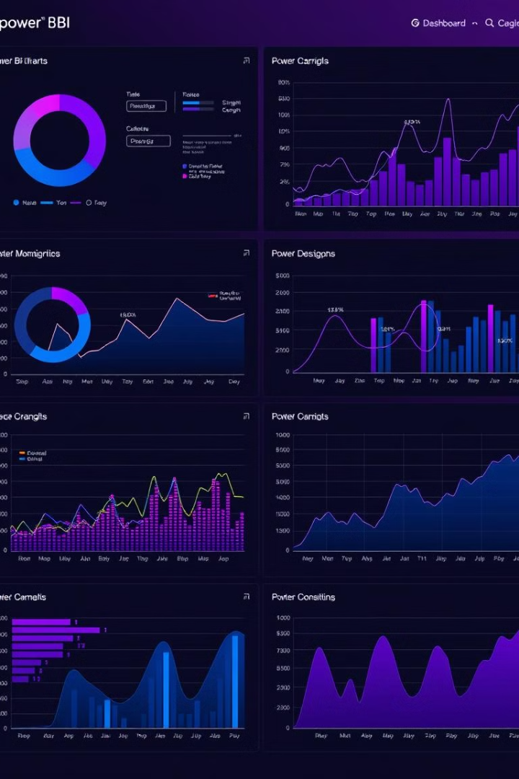
Visualizations and Dashboards in Power BI
1
Exploratory Analysis
Begin by creating a series of interactive visualizations to explore the data and identify key trends and patterns.
2
Dashboard Creation
Consolidate the most important insights into a comprehensive dashboard, enabling stakeholders to quickly and easily interpret the data.
3
Customization and Interactivity
Refine the dashboard with custom visuals, filters, and drill-down capabilities to allow for in-depth analysis and data exploration.

Slide 4
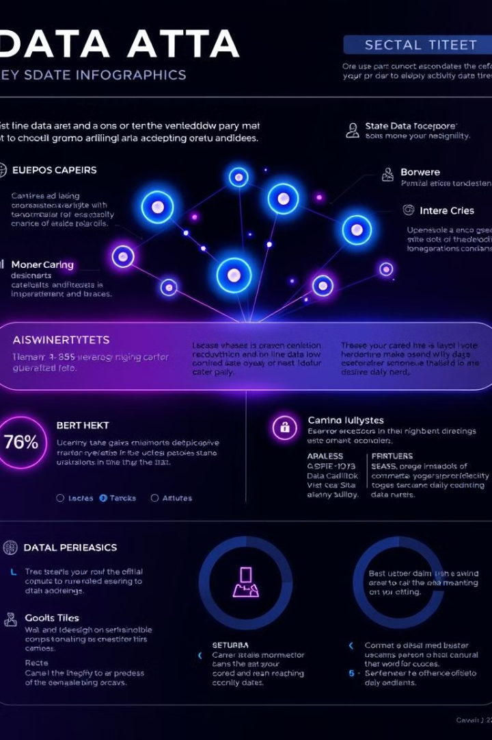
Key Insights and Findings
1
Sales Trends
2
Customer Behavior
Identify the best-selling products, top-performing regions, and seasonal fluctuations to guide strategic decision-making.
Analyze customer purchasing patterns, loyalty, and demographics to tailor marketing efforts and improve customer satisfaction.
3
Operational Efficiency
4
Competitive Landscape
Uncover areas for cost savings, inventory optimization, and process improvements to enhance overall business efficiency.
Benchmark performance against industry peers and identify opportunities to gain a competitive edge in the market.

Slide 5

Recommendations and Next Steps
Actionable Insights
Continuous Monitoring
Translate the key findings into actionable strategies and recommendations to drive tangible business improvements.
Establish ongoing data monitoring and reporting processes to ensure the insights remain relevant and responsive to market changes.
Stakeholder Engagement
Future Enhancements
Engage with key stakeholders to present the findings, gather feedback, and build a plan for implementing the recommendations.
Identify opportunities to expand the analysis, incorporate additional data sources, and refine the Power BI dashboard over time.

